Slide 1
Cancer in the School Community Supporting your student throughout their journey
School Nurse Update Conference
November 14, 2016

Slide 2
Facts and Figures
Pediatric Oncology Diagnosis Information

Slide 3
Pediatric Cancer
Childhood cancer is the leading cause of death by disease in children under the age of 15 in the U.S.
One in 285 children in the U.S. will be diagnosed with cancer by the time they are 20 years old.
Every year, an estimated 250,000+ new cases of cancer affect children under the age of 20 worldwide.
Two-thirds of childhood cancer patients will have long lasting chronic conditions from treatment.
In the United States, the incidence of cancer among adolescents and young adults is increasing at a greater rate than any other age group, except those over 65 years.
Childhood cancer is not just one disease. It is made up of a dozen types and countless subtypes.
Source: Alex’s Lemonade Stand Foundation
https://www.alexslemonade.org/childhood-cancer-facts-numbers

Slide 4
Pediatric Cancer
Blood cancers
Leukemia
AML
ALL
CML
Lymphoma
Hodgkins
Non-Hodgkins
Burkitts
Brain tumors
Astrocytoma
Ependymoma
Medulloblastoma
Glioma
Glioblastoma Multiforme (GBM)
Diffuse Intrinsic Pontine Glioma (DIPG)
Brainstem Glioma
Ganglioglioma
Optic Nerve Glioma

Slide 5
Pediatric Cancer
Solid Tumor
Ewing’s sarcoma
Germ Cell
Hepatoblastoma
Neuroblastoma
Osteosarcoma
Retinoblastoma
Rhabdomyosarcoma
Wilms’ Tumor

Slide 6
School Supports
Supports and services available to students

Slide 7
School Supports
Hospital Homebound Services
Full Time
Student must be medically unable to attend school
3 hours per week
Intermittent
Student must be expected to miss at least 10 days total during the school year related to their medical condition
Student is able to attend school when medically able and receive HHB services when medically unable
36 minutes per day

Slide 8
School Supports
504 Plan/Accommodations
shortened assignments; emphasize mastery and limit repetition
extra time to complete work and tests, including standardized tests
extra time to make up missed assignments
provide a 2nd set of books to be kept at home
unlimited rest breaks in a designated location
permission to have and drink water at the desk and during all activities
unlimited bathroom privileges
permission to eat snacks at the desk or to leave class and have them in a designated location as needed

Slide 9
School Supports
504 Plan/Accommodations
provide student with a copy of lecture notes, handouts, etc.
provide student with large print text on all reading/writing assignments
allow student to record lectures, class discussions, etc.
permission to wear a hat or other head covering (please provide a pass to show school personnel)
use of school elevator, wheelchair, crutches, walker, etc.
allow student to change classes before or after other students
provide student a peer buddy to walk with to classes

Slide 10
School Supports
504 Plan/Accommodations
intermittent hospital/homebound instruction
hospital-homebound attendance requirements for absences due to medical appointments and illness
partial-day attendance when necessary
a system for providing advance assignments to the parent for absences due to planned medical appointments
a system for providing make-up assignments in a timely manner when patient is absent due to illness or hospitalization

Slide 11
School Supports
IEP/Modifications
provide school-based OT, PT, Speech as recommended by medical team
provide skilled nursing services as recommended by medical team
provide a 1:1 parapro as recommended by medical team
allow student to dictate written assignments to a scribe
allow student to take tests orally

Slide 12
Late Effects
How cancer can impact learning after treatment

Slide 13
Learning Problems After Treatment
Factors that may place children and teens at increased risk for difficulties in school include:
Diagnosis of cancer at a very young age
Numerous or prolonged school absences
A history of learning problems before being diagnosed with cancer
Reduced energy levels
Cancer treatment that affects hearing or vision
Physical disabilities resulting from treatment
Cancer therapy that includes treatment to the central nervous system

Slide 14
Learning Problems After Treatment
Treatments which increase risk for educational difficulties:
Methotrexate – if given in high doses intravenously (IV) or injected into the spinal fluid (intrathecal – IT)
Cytarabine – if given in high doses intravenously (IV)
Surgery involving the brain
Radiation to any of the following areas:
Head or brain (cranial)
Brain and upper spine (craniospinal)
Eye or eye socket (orbital)
Ear
Face (including the sinuses, nose and mouth)
Total body

Slide 15
Learning Problems After Treatment
The brain is a very complex structure that continues to grow and develop throughout childhood and adolescence. Some problems may not become apparent until years after therapy is completed. Common problems areas include:
Handwriting
Spelling
Reading
Vocabulary
Math
Concentration
Attention span
Ability to complete tasks on time
Memory
Processing (ability to complete assignments requiring multiple steps)
Planning
Organization
Problem-solving
Social skills

Slide 16
How We Can Help
Services available through Children’s

Slide 17
CHOA School Program
Egleston = 5 teachers
Scottish Rite = 5 teachers
CIRU and Day Rehab = 2 teachers
Hughes Spalding = 1 teacher
Out of our total of 13 teachers, 6 teachers are dedicated to serve the patients in the Aflac Cancer and Blood Disorders Center.

Slide 18
CHOA School Program
Instructional Services
Serve as HHB teachers for students at all 3 hospital campuses
Provide instruction to hospitalized patients
Modify assignments as needed
Give patient’s teacher information about required modifications
Submit attendance verification for instructional time

Slide 19
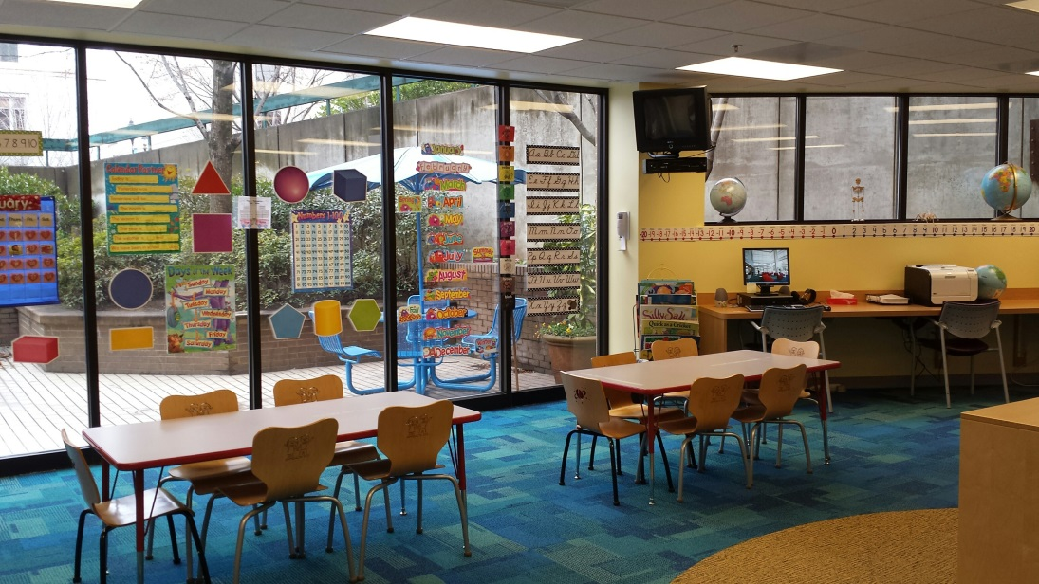
CHOA School Program
Instruction can be done on unit or at the bedside
Classrooms located on each campus (ECH, SR)

Slide 20
CHOA School Program
Advocacy Services
Communicate with school personnel to coordinate school services
Request school records to assist treatment team
Previous test scores and report cards
Current 504 plan or IEP (if applicable)
Assist with completion of Hospital/Homebound referral and Medical Report Form
Provide education specific to child’s injury/illness and the impact in the school setting
Request/modify assignments

Slide 21
CHOA School Program
Advocacy Services - Discharge planning
Make recommendations for additional services
School based therapies
504/IEP planning
Safety plan
Develop appropriate re-entry schedule
Partial days
Gradual return
Provide additional resources for parents/families/schools

Slide 22
Questions?

